Slide 1
External Team Meetings | Length | Cadence | Agenda
ART Sync | 60 minutes | Once a sprint (Last Monday) | Give a high level Product status to stake holders for all the Artifacts identified during PI Planning.
Scrum of Scrums | 30 minutes | Once a week (Thursday) Closer to testing sprints, twice a week (Tuesday and Thursday) | Track dependencies on all line items on the Integration Tracker from Testing/Release point of view based on due dates.
CloudEagles/DevOps Dependency Call | 30 minutes | Once a week (Friday) | Discuss all new dependencies with DevOps team and follow up on existing dependencies.
Sprint Review/Demo | 210 minutes | Once a sprint (Last Tuesday) | Demo all features and functionalities completed in the sprint
DevOps Connect | 30 minutes | Twice a week (Tuesday and Thursday) | TA’s and DevOps connect for all technical discussions
Internal Team Meetings | Length | Cadence | Agenda
Daily Scrum | 15 minutes | Daily | Sprint Task Status, Blockers
Refinements | 60 – 90 minutes | Twice a week (Tuesday and Thursday)/As needed. | Groom User stories/Scope
Sprint Retrospective | 60 minutes | Once a sprint (Last Tuesday) | What went well/bad in the sprint & Ideas for future
Sprint Planning | Upto 360 minutes | Once a sprint (First Wednesday) | Planning scope for new sprint

Slide 2
Audit Transformations: PI Cadence & Release Dates
Iteration # | Start Date | Finish Date | Release Date | PI Planning
81 - 1 | Mar 31, 2021 | Apr 20, 2021
82 - 2 | Apr 21, 2021 | May 11, 2021
83 - 3 | May 12, 2021 | June 1, 2021
84 – Testing | June 2, 2021 | June 22, 2021
85 - IP | June 23, 2021 | July 13, 2021 | July 17, 2021 (Audit Online & DAD) July 13 (AQMM) | PI 6 - July 13 - 15, 2021
86 – 1 | July 14, 2021 | Aug 3, 2021
87 – 2 | Aug 4, 2021 | Aug 24, 2021
88 – 3 | Aug 25, 2021 | Sep 14, 2021
89 - 4 | Sep 15, 2021 | Oct 5, 2021 | (EMS)
90 – Testing | Oct 6, 2021 | Oct 26, 2021
91 – IP | Oct 27, 2021 | Nov 16, 2021 | Nov 13, 2021 (Audit Online & DAD), | PI 7 - Nov 9 – 11, 2021
92 – 1 | Nov 17, 2021 | Dec 7, 2021
93 – 2 | Dec 8, 2021 | Dec 28, 2021
94 – 3 | Dec 29, 2021 | Jan 18, 2022
95 – 4 | Jan 19, 2022 | Feb 8, 2022
96 – 5 | Feb 9, 2022 | Mar 1, 2022
97 – IP | Mar 2, 2022 | Mar 22, 2022 | Mar 19 (Audit Online, DER & DAD) | PI 8 - Mar 15 – 17, 2022

Slide 3
Audit Transformations: PI Cadence & Release Dates
Iteration # | Start Date | Finish Date | Release Date | PI Planning
98 - 1 | Mar 23, 2022 | Apr 12, 2022
99 - 2 | Apr 13, 2022 | May 3, 2022
100 - 3 | May 4, 2022 | May 24, 2022
101 – 4 ½ testing | May 25, 2022 | June 14, 2022 | June 6 – 14, Mid Release Testing
102 - 5 | June 15, 2022 | July 5, 2022
103 – 6 | July 6, 2022 | July 26, 2022
104 – 7 – ½ testing | July 27, 2022 | Aug 16, 2022
105 – Testing | Aug 17, 2022 | Sep 6, 2022 | UAT – Aug 22 – 26, 2022
106 - IP | Sep 7, 2022 | Sep 27, 2022 | Sep 17, 2022 | PI 9 – Sep 20 – 22, 2022
107 -1 | Sep 28, 2022 | Oct 18, 2022
108 – 2 | Oct 19, 2022 | Nov 8, 2022
109 – 3 | Nov 9, 2022 | Nov 28, 2022
110 – 4 1/2 testing | Nov 29, 2022 | Dec 20, 2022 | Dec 12 – 20, Mid Release Testing
111 – 5 | Dec 21, 2022 | Jan 10, 2023
112 – 6 | Jan 11, 2023 | Jan 31, 2023
113 – 7 – ½ testing | Feb 1, 2023 | Feb 21, 2023
114 – Testing | Feb 22, 2023 | Mar 14, 2023 | UAT Mar 6 – 10, 2023
115 – IP | Mar 15, 2023 | Apr 4, 2023 | March 25, 2023 | PI 10 – Mar 28 – 30. 2023

Slide 4
Audit Transformations: PI Cadence & Release Dates
Iteration # | Start Date | Finish Date | Release Date | PI Planning
116 – 1 | Apr 5, 2023 | Apr 25, 2023
117 – 2 | Apr 26, 2023 | May 16, 2023
118 – 3 | May 17, 2023 | June 6, 2023
119 – 4 ½ testing | June 7, 2023 | June 27, 2023
120 – 5 | June 28, 2023 | July 18, 2023
121 - 6 | July 19, 2023 | Aug 8, 2023
122 – 7 – ½ testing | Aug 9, 2023 | Aug 29, 2023
123 – Testing | Aug 29, 2023 | Sep 19, 2023 | Sept 10
124 – IP | Sep 20, 2023 | Oct 10, 2023 | Sep 30, 2023 | PI 11 - Oct 3 – 4, 2023 (Oct 2 will be USI holiday)

Slide 5

PI6 Milestones *
*This is for products releasing around end of PI. For those not releasing in November, your Code Freeze dates and UAT may differ. Please confirm with your SM/DL/TL for schedule.
Start: July 14, 2021
Official Start: July 16, 2021
4 Development Sprints
First Sprint – 3 weeks
Second Sprint – 3 weeks
Third sprint – 3 weeks
Fourth Sprint should allow for buffer – 1.5 weeks for those releasing in November
RC 1 (Bronze) Code Freeze: Sep 24, 2021; only P1/P2 defects post
Regression, Performance, Backward Compatibility, China, Integration, PEN – Start Sep 27, 2021
RC 2 (Silver) Code Freeze: 8 October, 2021; only showstoppers P1 post
UAT – Week of 11 October 2021
Gold Code: 29 Oct 2021; Gold Code=Ready for Staging
Production Deployment:
Nov 13 for AO
Innovation Sprint: Sprint 91; begins 27 October 2021
PI Planning for Nov PI: (Nov 9 - 11, 2021)
Start next release on Nov 17 (March 2022 release)

Slide 6
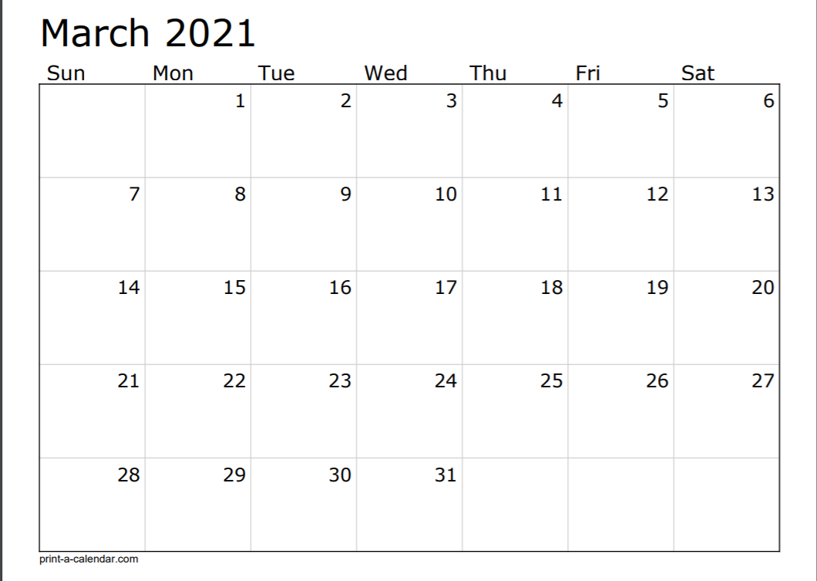



Final UAT
Testing (Regression, China, Backward, Integration, Performance) and Critical Defects
Ad Hoc Testing/Buffer
Gold Code
Sprint 80
Technical Deployment
PI Planning - 5
AO Deploy
AO Start
Sprint 81

Slide 7
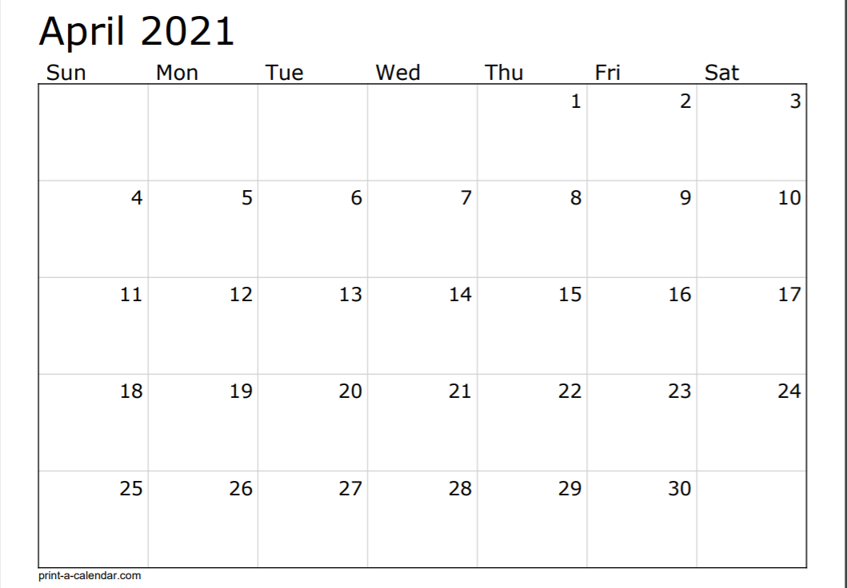
AQMM Deploy
ER Deploy
CMS Deploy
Sprint 82

Slide 8
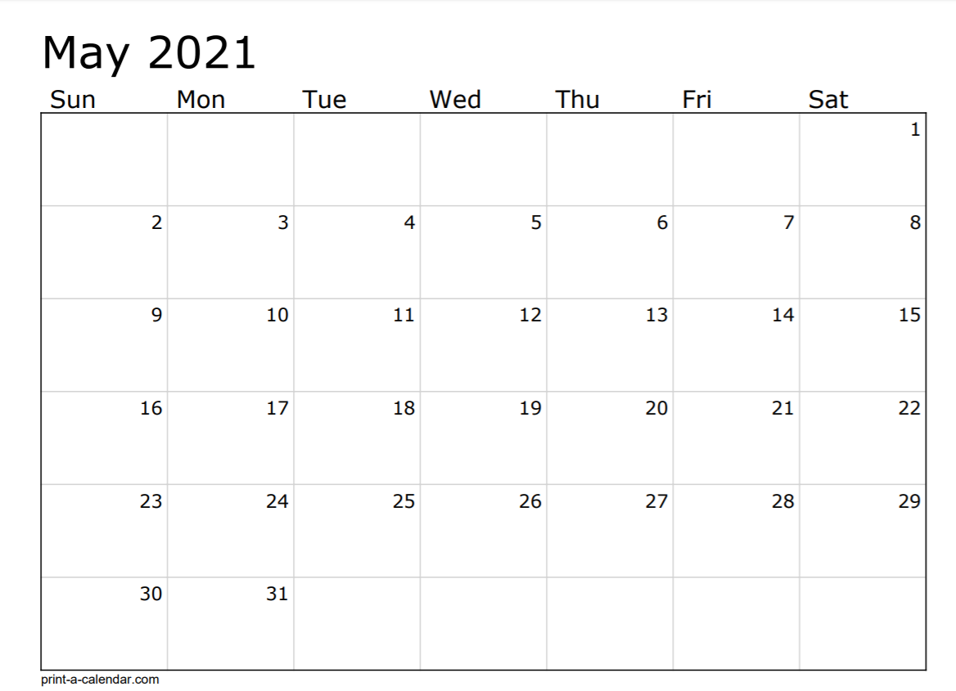

Sprint 83
USI – Holiday
AO Code Freeze
Testing (Regression, China, Backward, Integration, Performance) and Critical Defects
US Holiday

Slide 9
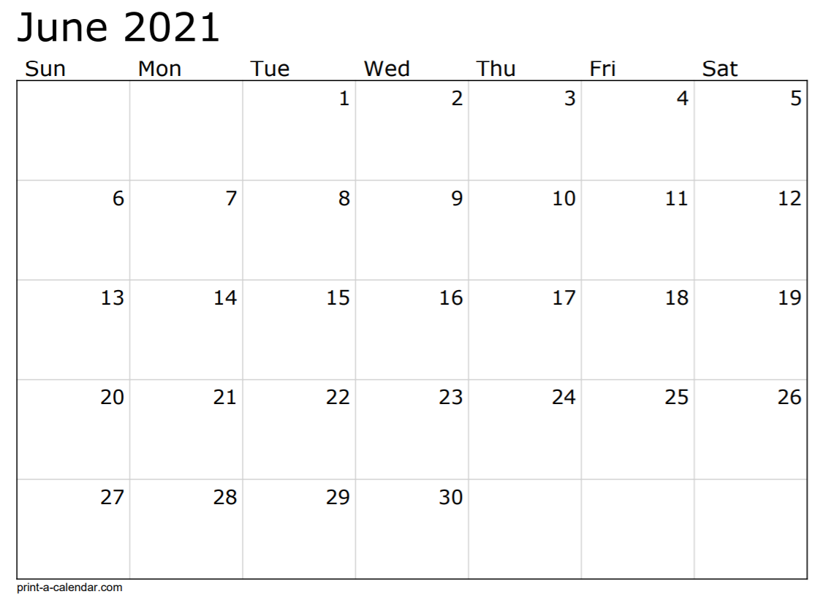
Testing (Regression, China, Backward, Integration, Performance) and Critical Defects
USI – Holiday
Sprint 84
Testing (Regression, China, Backward, Integration, Performance) and Critical Defects
Testing complete
Testing (Regression, China, Backward, Integration, Performance) and Critical Defects
Final UAT
Ad Hoc Testing/Buffer
AO Gold Code
Sprint 85
Tech Deployment

Slide 10
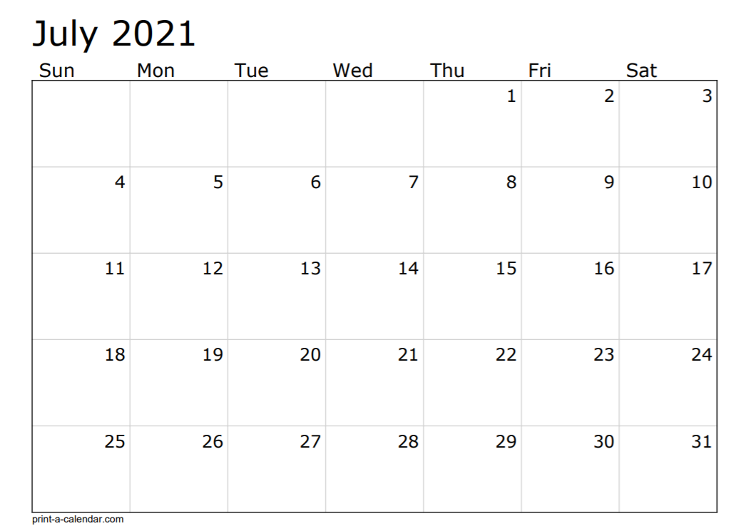
Tech Deployment
AO/ER Code Package
US Holiday
US Holiday
AQMM Deploy
AO Start
PI Planning - 6
Sprint 86
AO/DAD Deploy

Slide 11
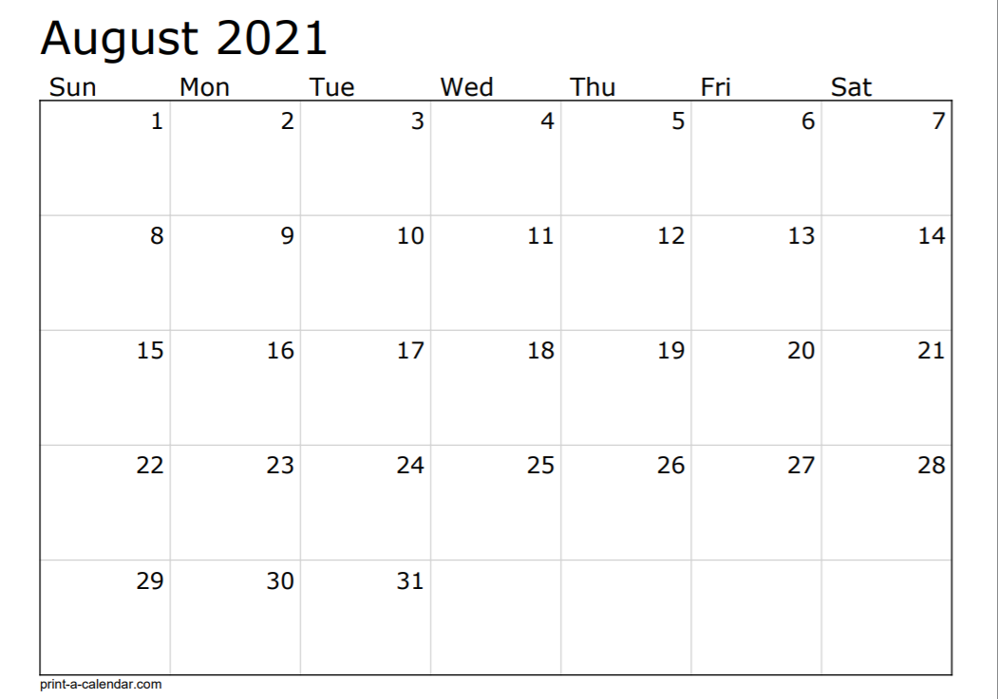
Sprint 87
BCP POC Testing
Sprint 88

Slide 12
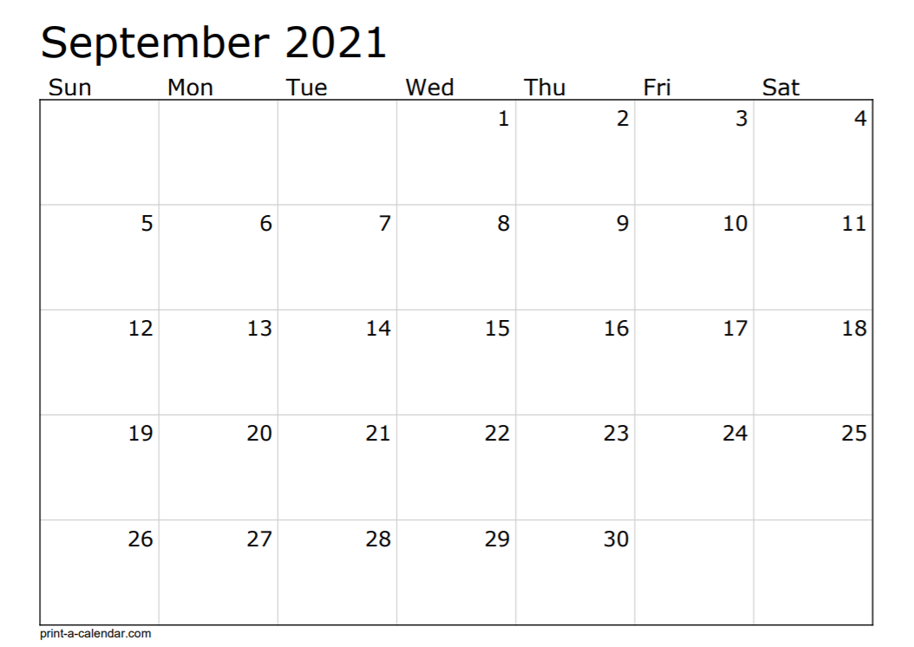

US Holiday
USI – Holiday
BCP Password Rotation Testing
Iconfirm Build
Sprint 89
AO Bronze Code
AO Code Freeze
Testing (Regression, China, Backward, Integration, Performance) and Critical Defects

Slide 13
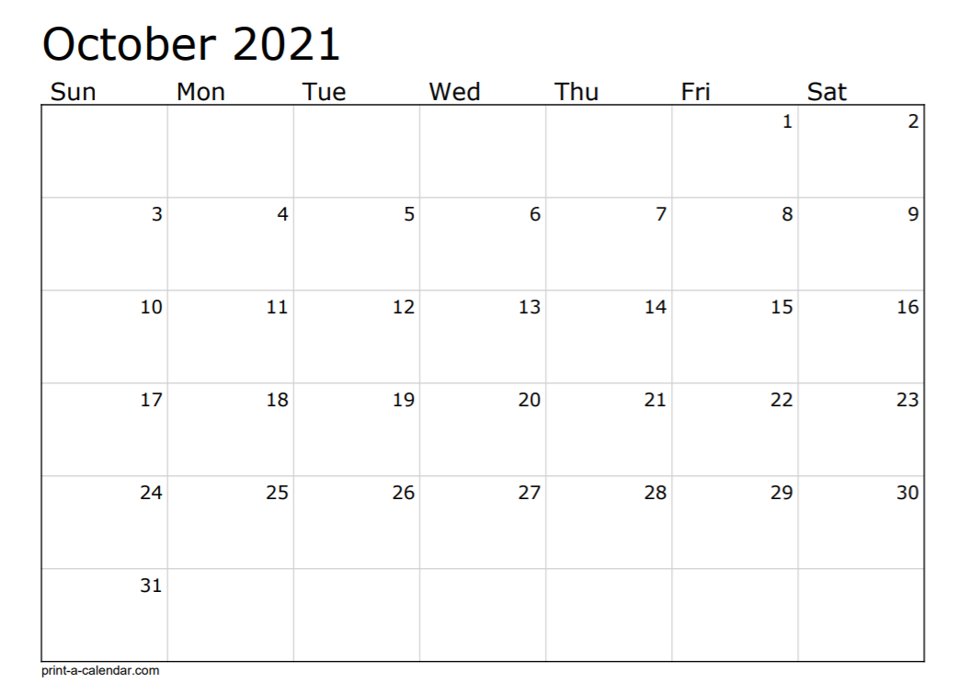

AO Silver Code
Pen Testing
Testing (Regression, China, Backward, Integration, Performance) and Critical Defects
Sprint 90
ER Deploy
Pen Testing
Final UAT
Testing (Regression, China, Backward, Integration, Performance) and Critical Defects
USI – Holiday
Pen Testing
Testing (Regression, China, Backward, Integration, Performance) and Critical Defects
Pen Testing
AD Hoc Testing/Buffer
AO Gold Code
Sprint 91

Slide 14
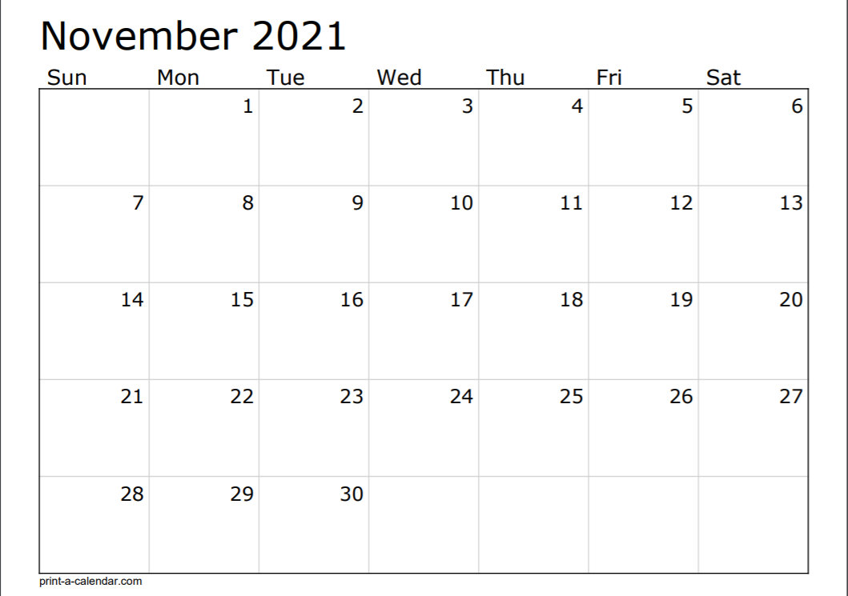
Tech Deployment
USI – Holiday
AO /DAD Deploy
PI Planning - 7
AO Start
AQMM Deploy
Sprint 92
US Holiday

Slide 15
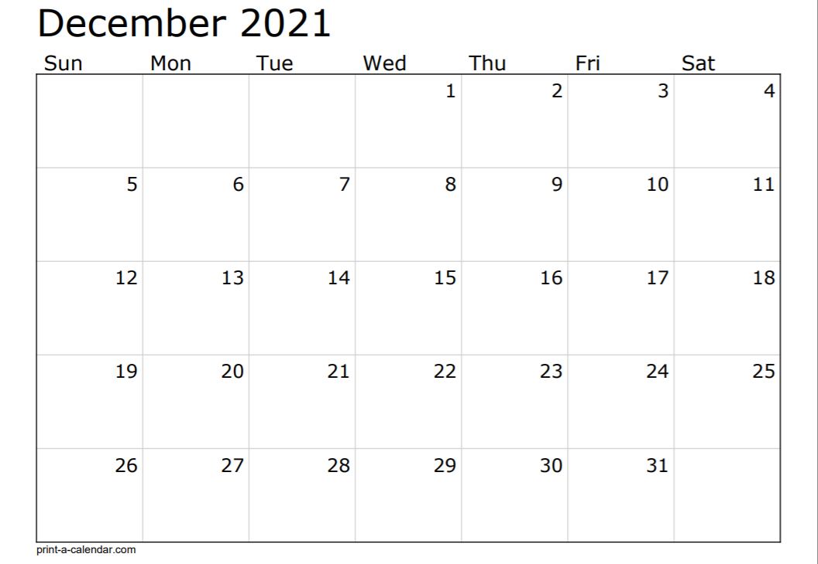
Password Rotation Testing
Sprint 93
US/USI - Holiday
Sprint 94

Slide 16
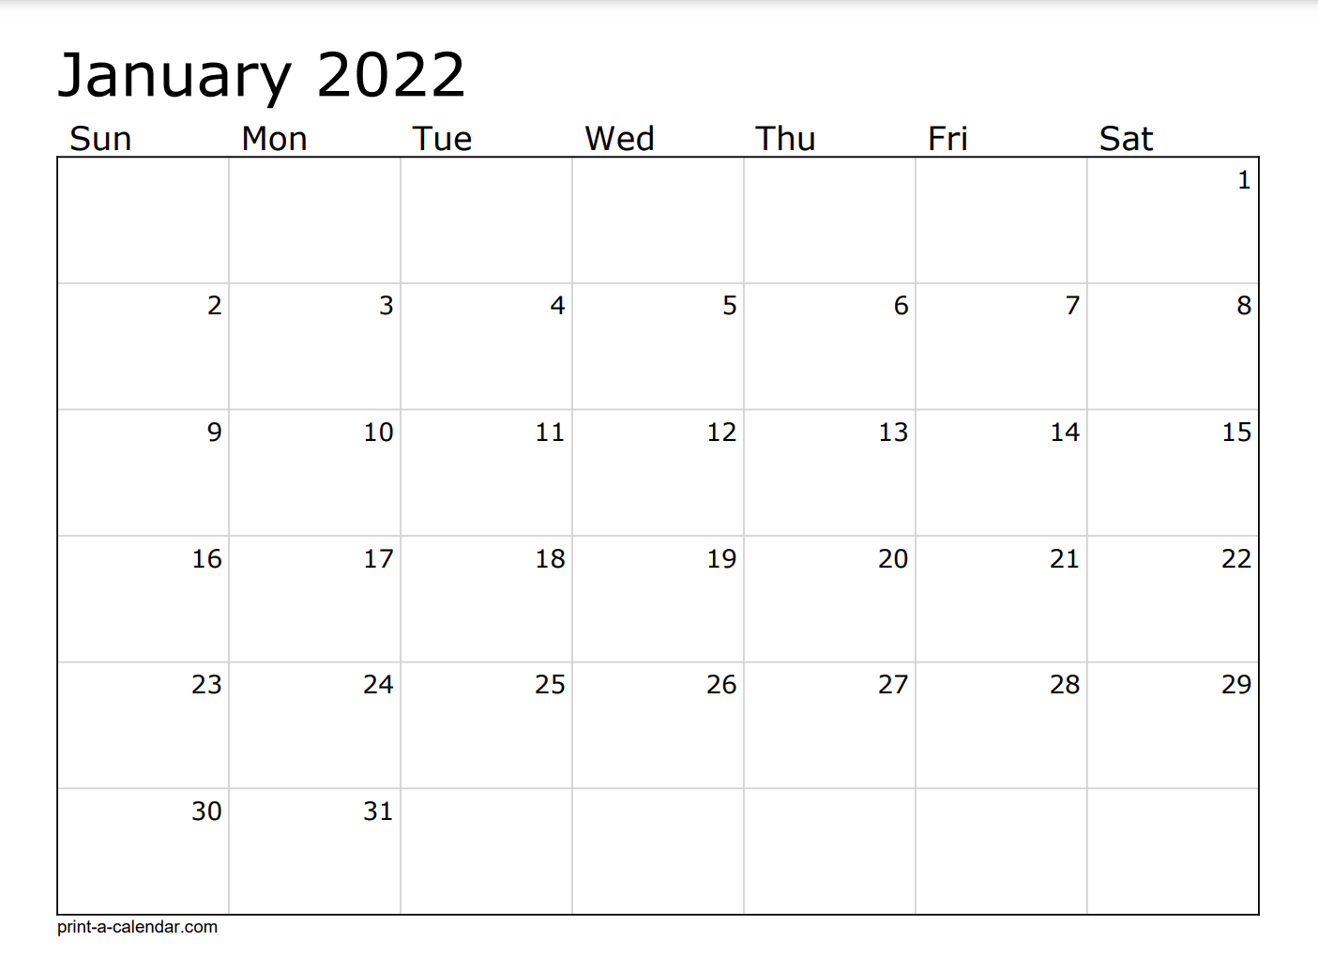
USI – Holiday
US Holiday
Sprint 95
AO Code Freeze
USI – Holiday

Slide 17
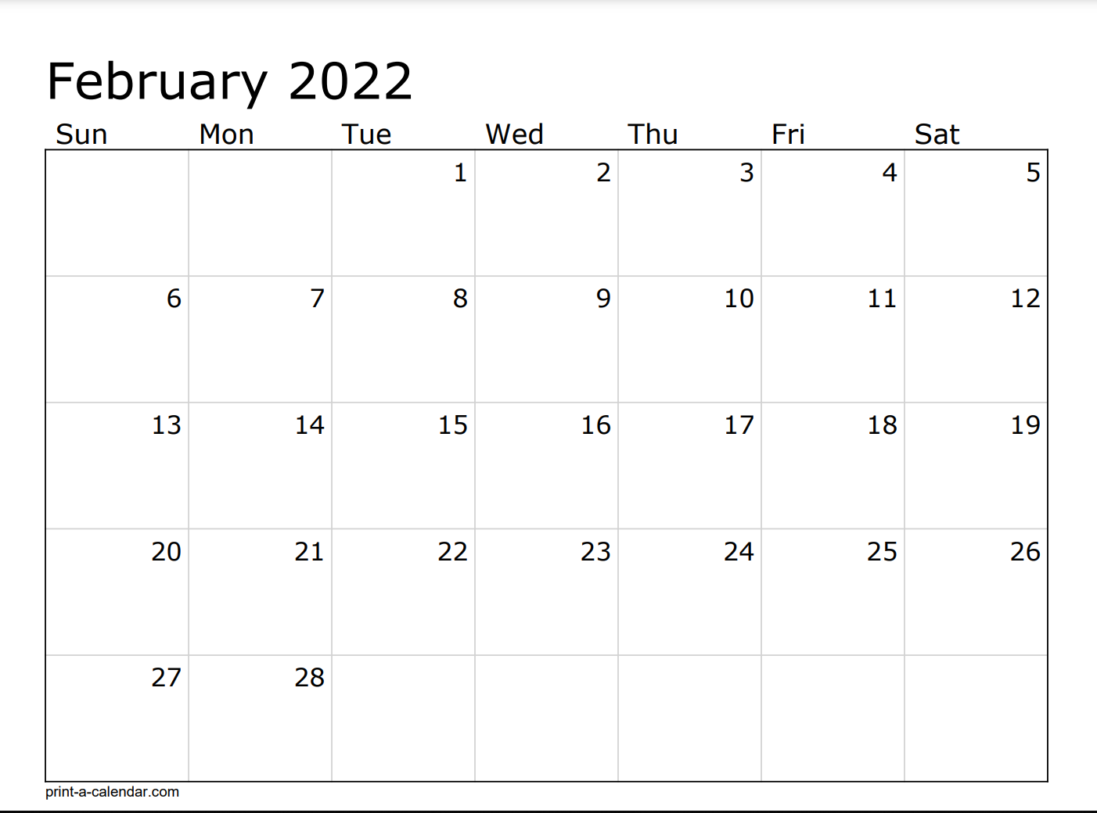
Testing (Regression, China, Backward, Integration, Performance) and Critical Defects
Testing (Regression, China, Backward, Integration, Performance) and Critical Defects
Sprint 96
Testing (Regression, China, Backward, Integration, Performance) and Critical Defects
Final UAT
Testing (Regression, China, Backward, Integration, Performance) and Critical Defects
Ad Hoc Testing/Buffer

Slide 18
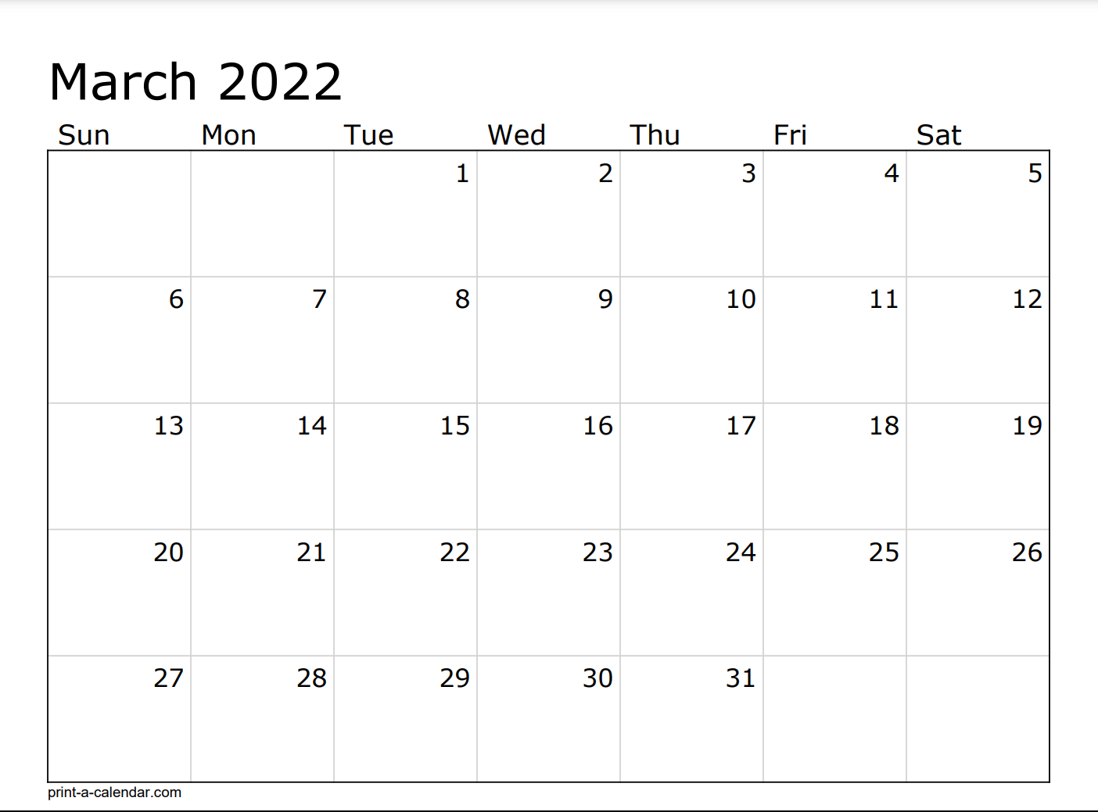
Ad Hoc testing/Buffer
Gold Code
Sprint 97
Technical Deployment
AQMM/ENS Deploy
AO/ER/DAD Deploy
PI Planning - 8
AO Start
Sprint 98 - 1

Slide 19
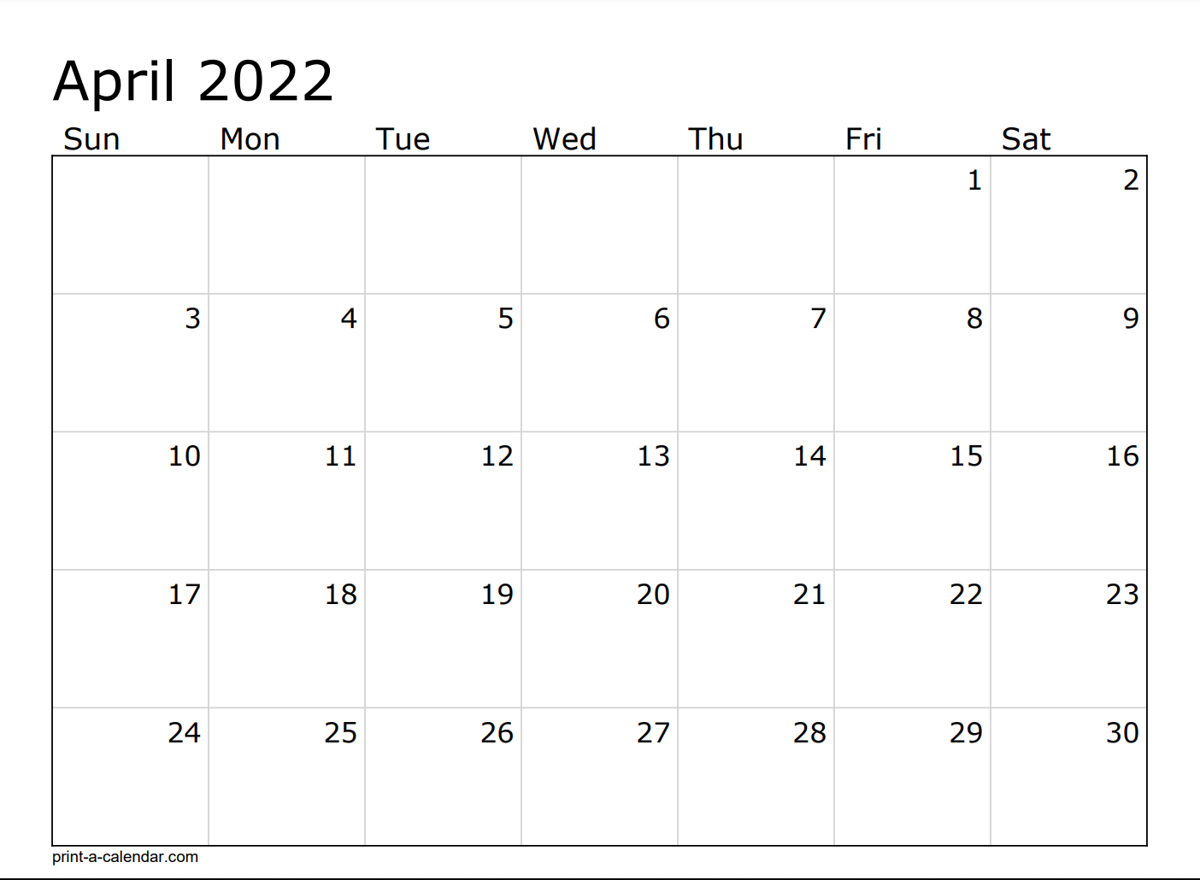
Sprint 99 - 2
USI – Holiday

Slide 20
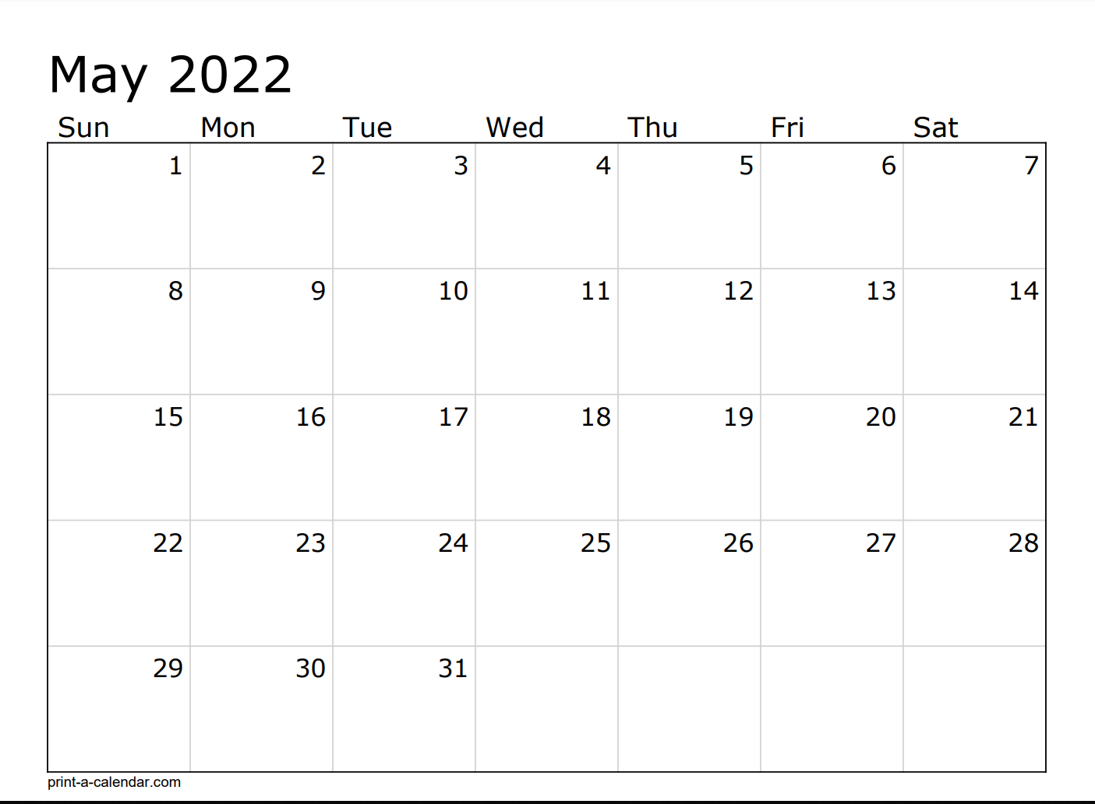
USI – Holiday
Sprint 100 - 3
Sprint 101 – 4 – ½ Testing
US Holiday

Slide 21
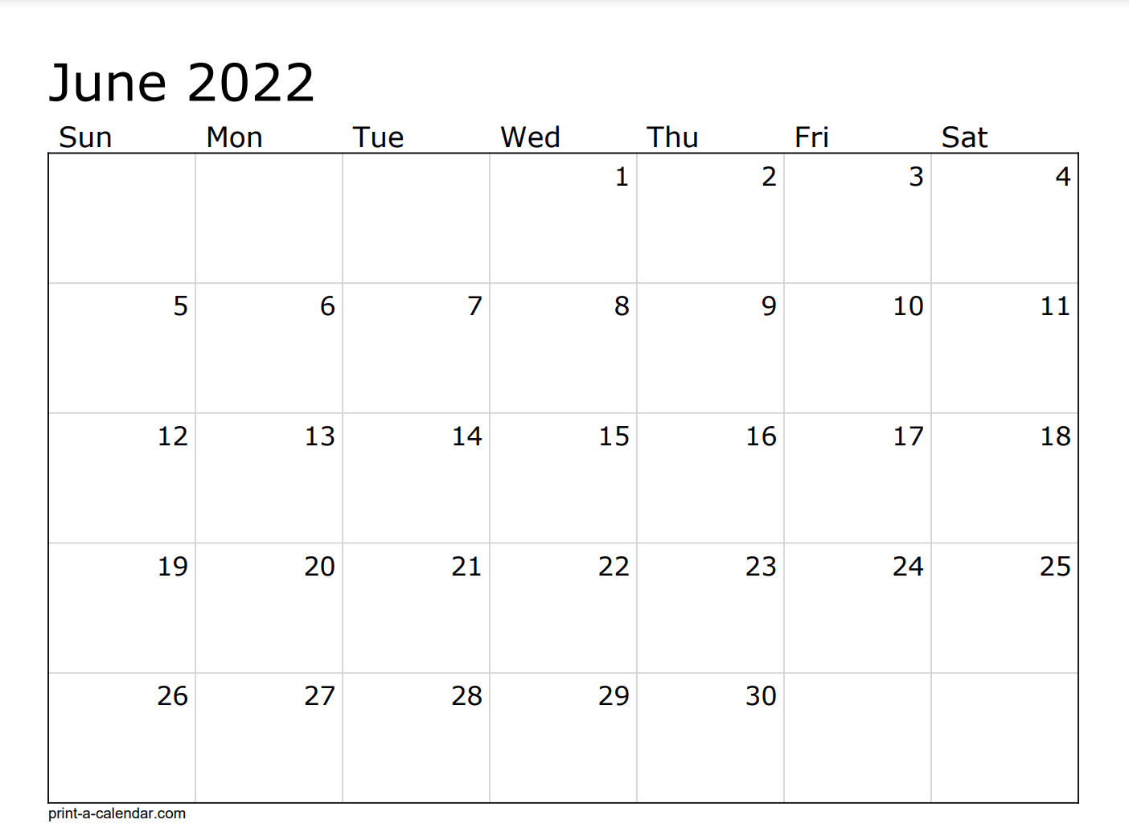
USI – Holiday
Mid Release Testing
Mid Release Testing
Sprint 102 - 5
Gold Code

Slide 22
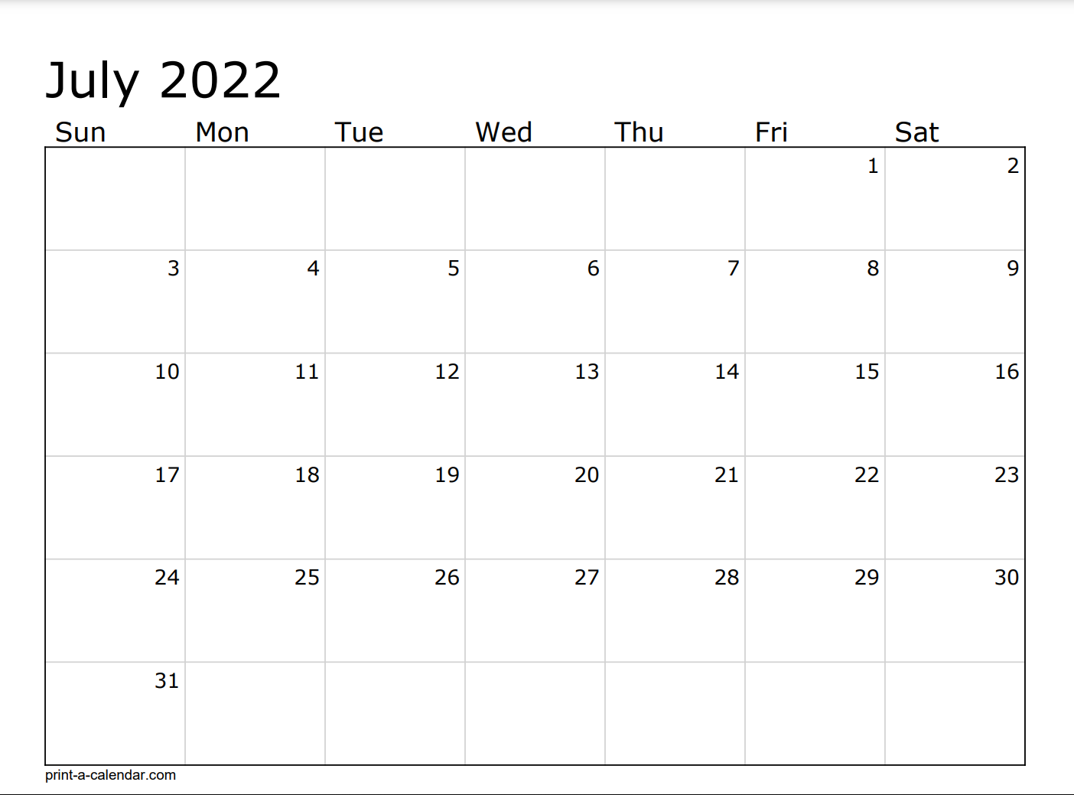
US Holiday
Sprint 103 - 6
Sprint 104 – 7 – ½ Testing

Slide 23
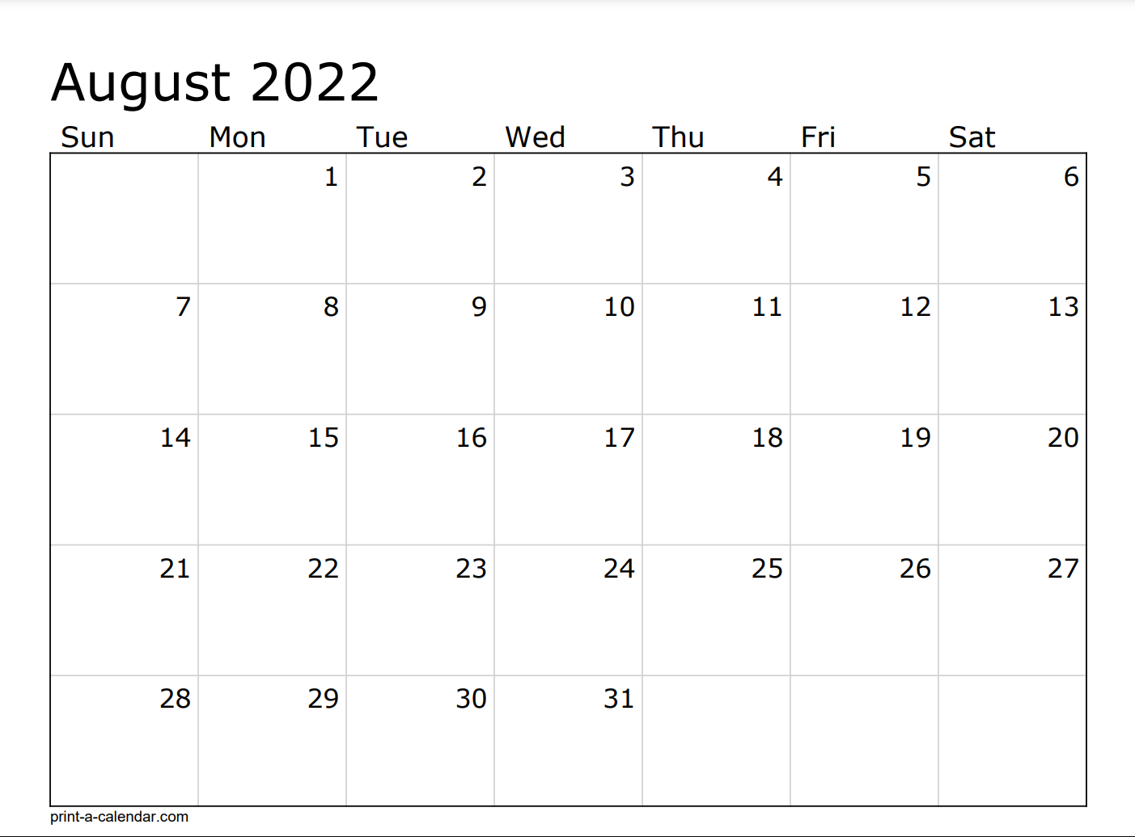
AO Code Freeze
Testing (Regression, China, Backward, Integration, Performance) and Critical Defects
USI – Holiday
Testing (Regression, China, Backward, Integration, Performance) and Critical Defects
USI – Holiday
Sprint 105 - Testing
Final UAT
Testing (Regression, China, Backward, Integration, Performance) and Critical Defects
Testing (Regression, China, Backward, Integration, Performance) and Critical Defects
USI – Holiday

Slide 24
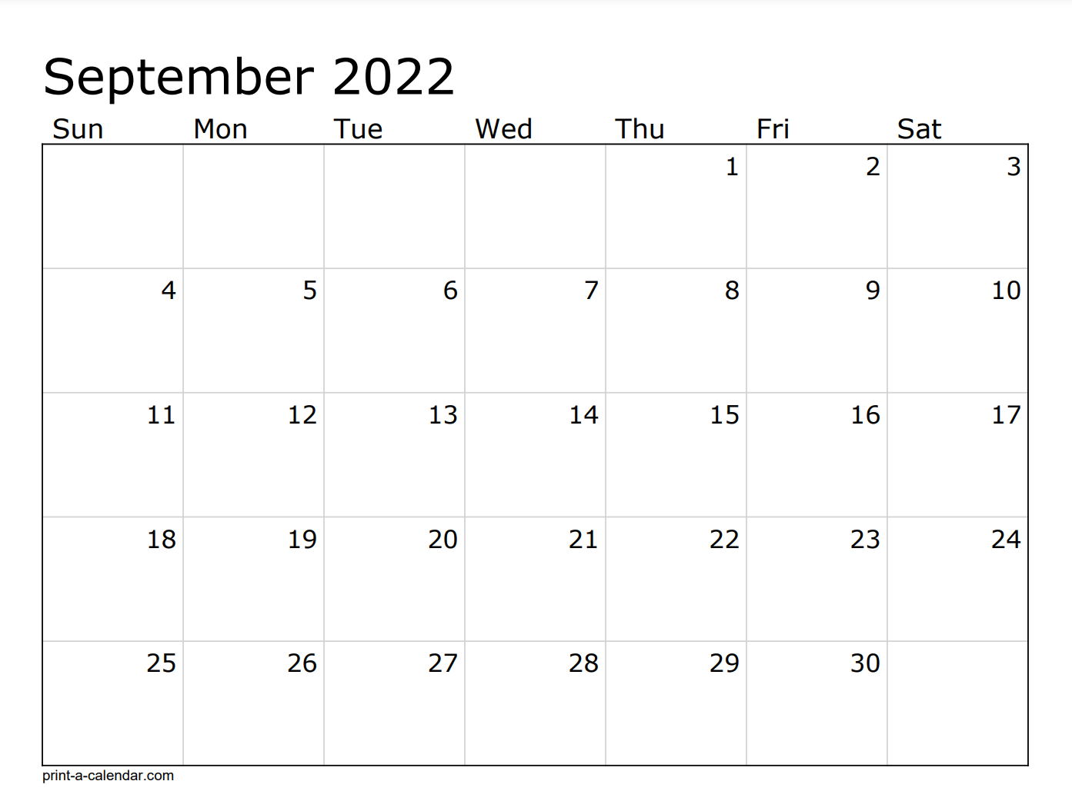

Test Complete
Testing (Regression, China, Backward, Integration, Performance) and Critical Defects
Ad Hoc/Buffer
AO Gold Code
US Holiday
Sprint 106 - IP
AO Deploy
Technical Deployment
PI Planning - 9
AO Start
Sprint 107 - 1

Slide 25
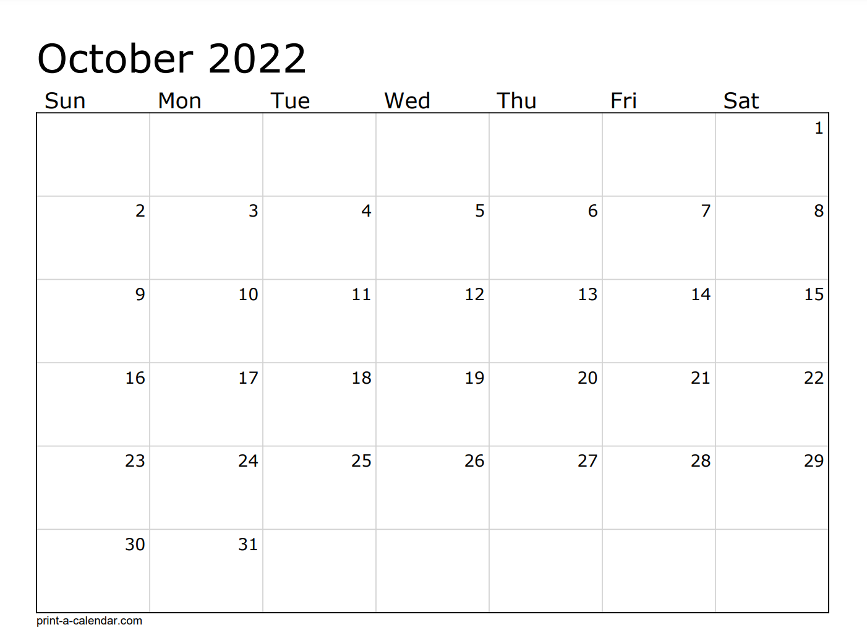
USI – Holiday
Sprint 108 - 2
USI – Holiday

Slide 26
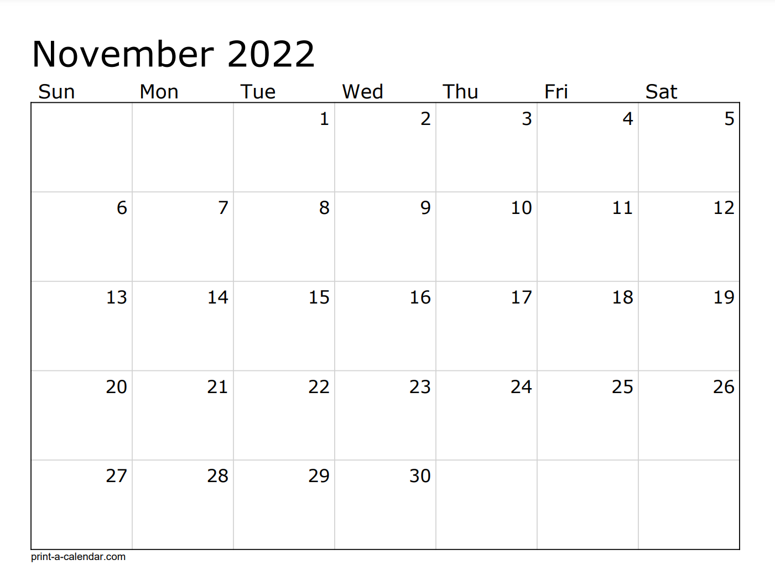
Sprint 109 - 3
US Holiday
Sprint 110 – 4 -1/2 Testing

Slide 27
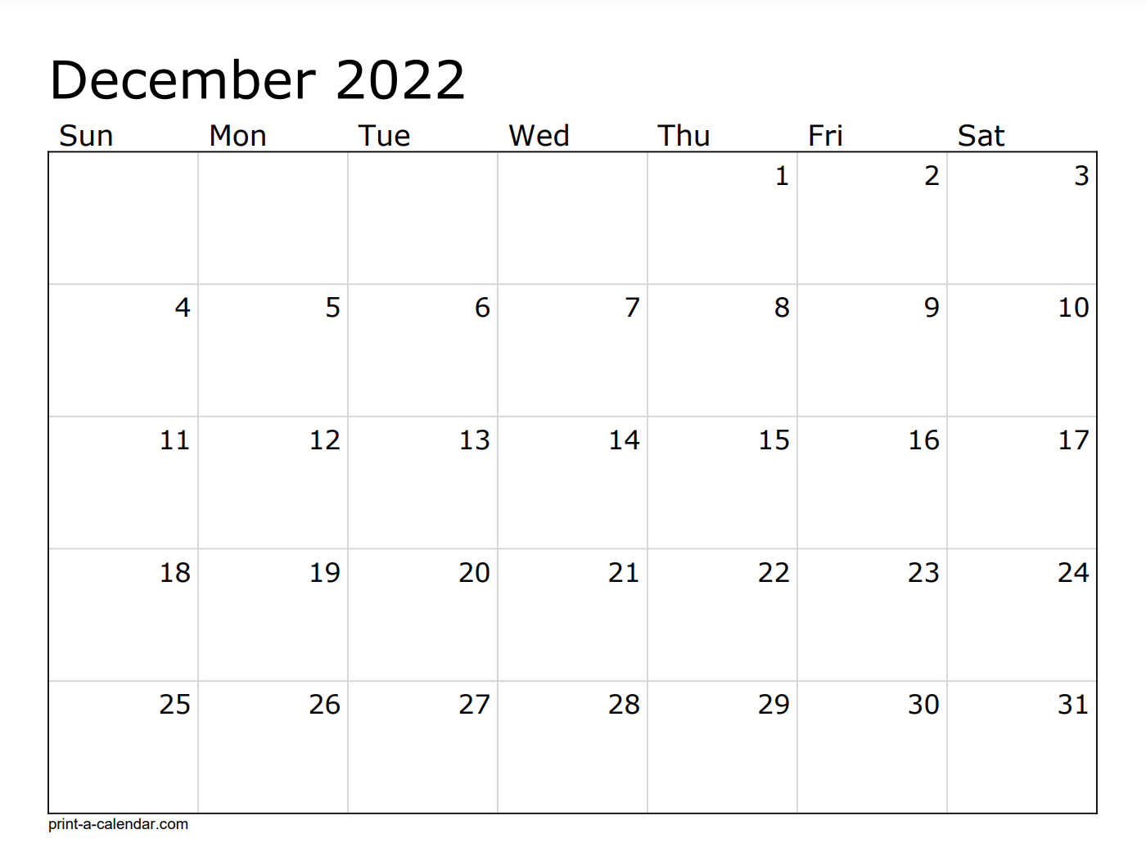
Mid Release Testing
AO Code Freeze
Mid Release Testing
Sprint 111 - 5
US/USI - Holiday

Slide 28
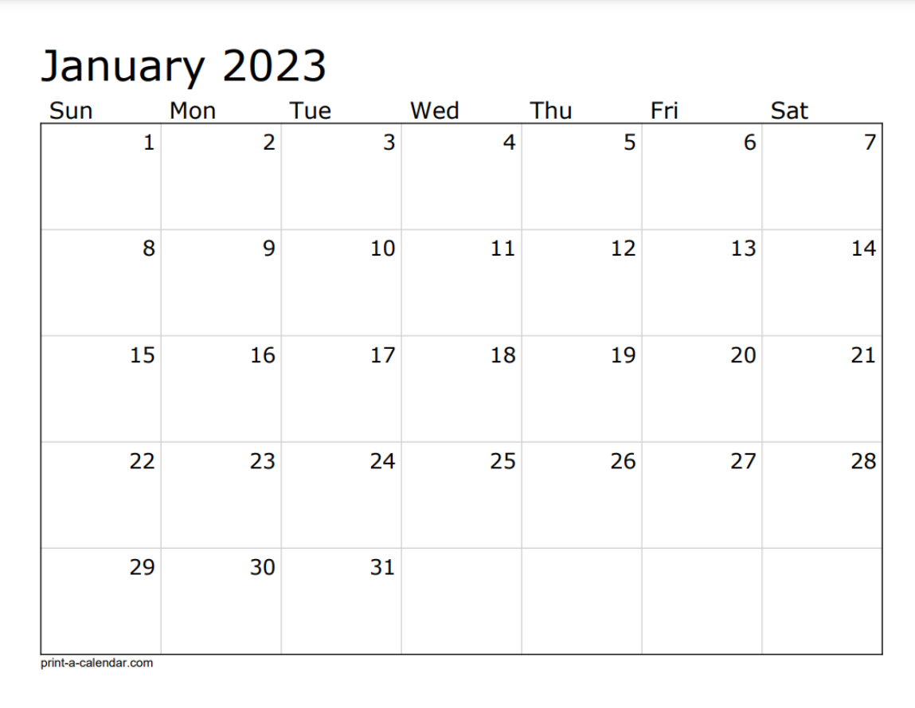
Sprint 112 - 6
US Holiday

Slide 29
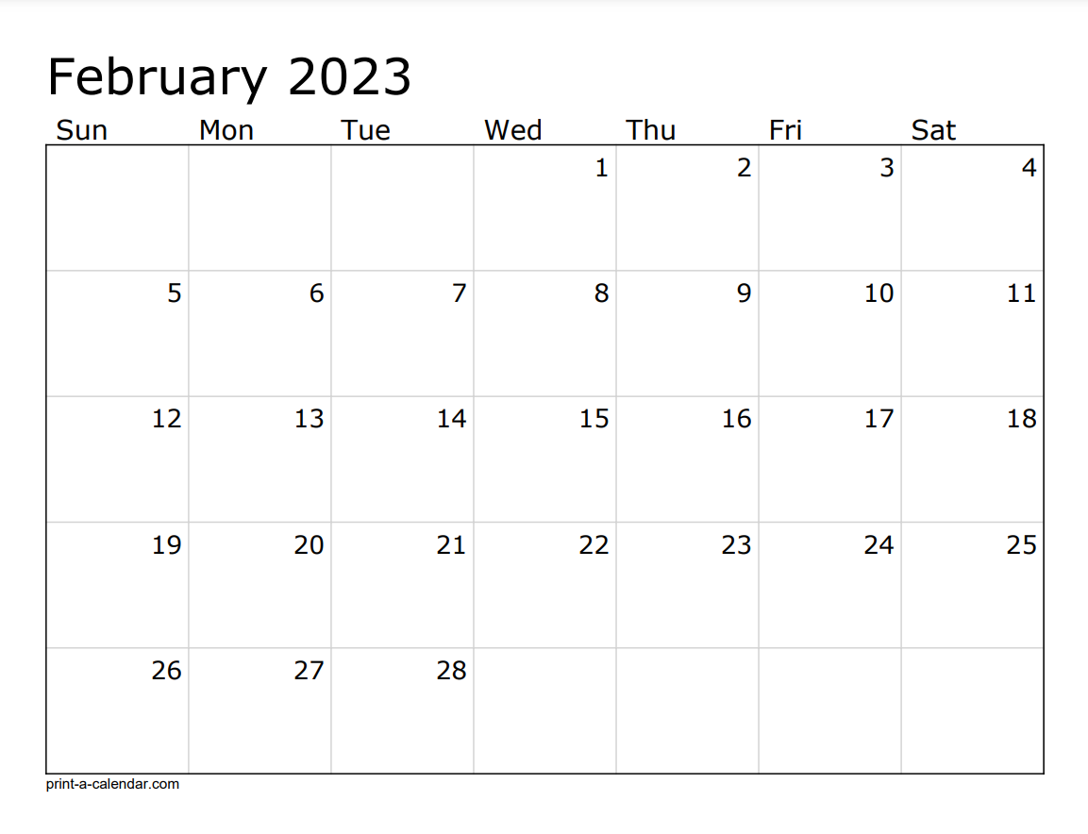
Sprint 113 –7-½- Testing
AO Code Freeze
Testing (Regression, China, Backward, Integration, Performance) and Critical Defects
Testing (Regression, China, Backward, Integration, Performance) and Critical Defects
Sprint 114 - Testing
Testing (Regression, China, Backward, Integration, Performance) and Critical Defects

Slide 30
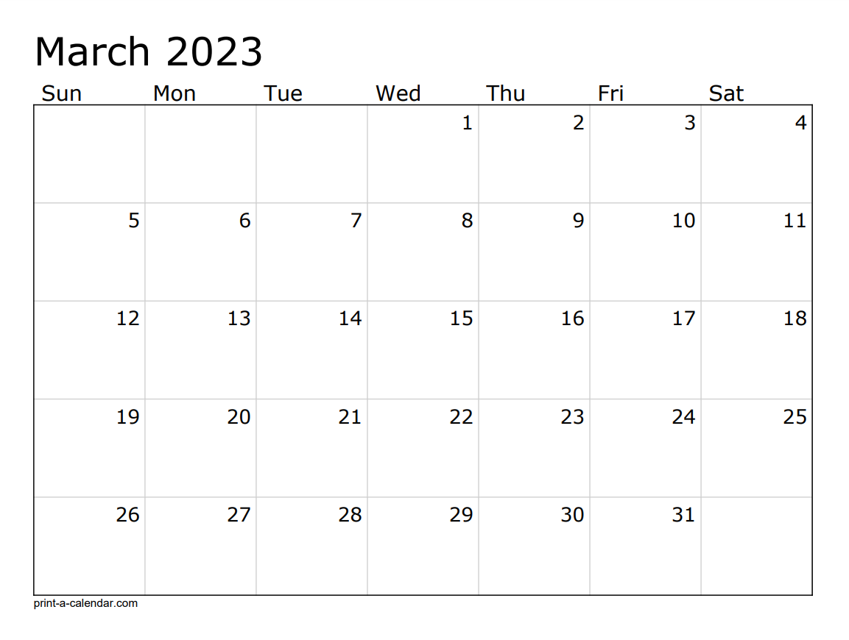
Testing (Regression, China, Backward, Integration, Performance) and Critical Defects
Test Complete
Testing (Regression, China, Backward, Integration, Performance) and Critical Defects
Final UAT
Ad Hoc/Buffer
Sprint 115 - IP
AO Gold Code
Technical Deployment
AO Deploy
PI Planning – 10

Slide 31
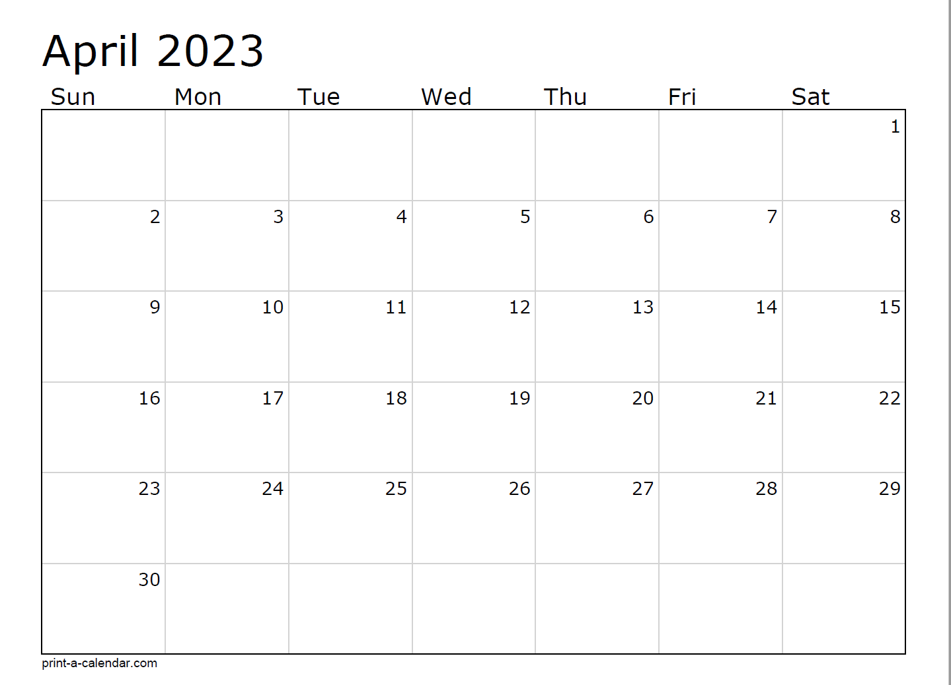
AO Start
Sprint 116 - 1
Sprint 115 - IP

